Slide 1


The Skill Swap Network
~A platform to trade skills and services without money
T.E.(I.T.) / Sem V / MINI- PROJECT-2025
Project Guide :- Prof. Vaishali Kavatekar
Ryan Dsouza - TE IT
Sana Nadulkeri – TE IT
Jobin Abraham –TE IT
Rohit Solanki - TE IT

Slide 2
Introduction
The Skill Swap Network is a community-driven platform that enables businesses to exchange services and expertise without using money. Instead of monetary transactions, companies offer their strengths in one area in return for services they need. By connecting businesses with complementary skills, the Skill Swap Network encourages cost-effective, inclusive, and sustainable business growth.

Slide 3
Problem Statement
Many startups and small businesses cannot afford important services like design, legal help, or marketing due to tight budgets. This slows their growth and puts them at a disadvantage. Meanwhile, these businesses have skills they could exchange but lack a trusted, organized way to do so without money.

Slide 4
Scope of Problem
Solution: A secure, simple platform to list offers/needs, make fair exchanges, and build trust — turning skills into growth instead of spending cash.
Scope:
Users: Startups, freelancers, SMEs
Need: Affordable services via structured skill exchange
Challenge: No trusted digital barter platform

Slide 5
Current Scenario
In today’s fast-paced digital economy, access to skills is more critical than ever. However, many individuals—especially freelancers, students, and small business owners—struggle to afford quality training or professional services. While online learning platforms and gig marketplaces exist (like Coursera, Fiverr, and Upwork), they often involve high fees, subscriptions, or monetary transactions that create barriers for those with limited budgets.
Traditional barter systems have existed informally through social media groups and local communities, but these lack structure, security, and scalability. There is no mainstream, trusted platform solely dedicated to skill-for-skill exchanges. As a result, countless opportunities for mutual growth and collaboration go untapped.

Slide 6
Need for the Proposed System
The Skill Swap Network addresses this gap by creating a trusted, structured platform for skill-based exchange. It empowers users to:
Gain services without financial burden, making personal and professional development more accessible.
Maximize underutilized skills by transforming them into a valuable currency.
Build connections and trust in a collaborative community.
Reduce economic inequality by promoting knowledge sharing across diverse social and economic groups.
Encourage sustainable development, as skill exchange reduces the need for constant monetary flow and fosters mutual support.
Thus, there is a growing need for a digital barter system like the Skill Swap Network that encourages fair, flexible, and community-driven growth.

Slide 7
Literature Review
Skill exchange platforms have roots in concepts like Time Banking and LETS (Local Exchange Trading Systems), where services are traded based on time or mutual benefit rather than money (Cahn, 2000). These systems promote inclusivity and strengthen community bonds.
With the rise of the sharing economy, digital platforms such as Skillshare and Simbi have shown how technology can facilitate peer-to-peer learning and service exchange (Botsman & Rogers, 2010). Research indicates that users are driven not only by cost-saving but also by personal growth and social interaction (Bellotti et al., 2015).
Trust is a key factor in these platforms. Features like user reviews, transparency, and verified profiles enhance credibility and encourage participation (Lampinen et al., 2013).

Slide 8
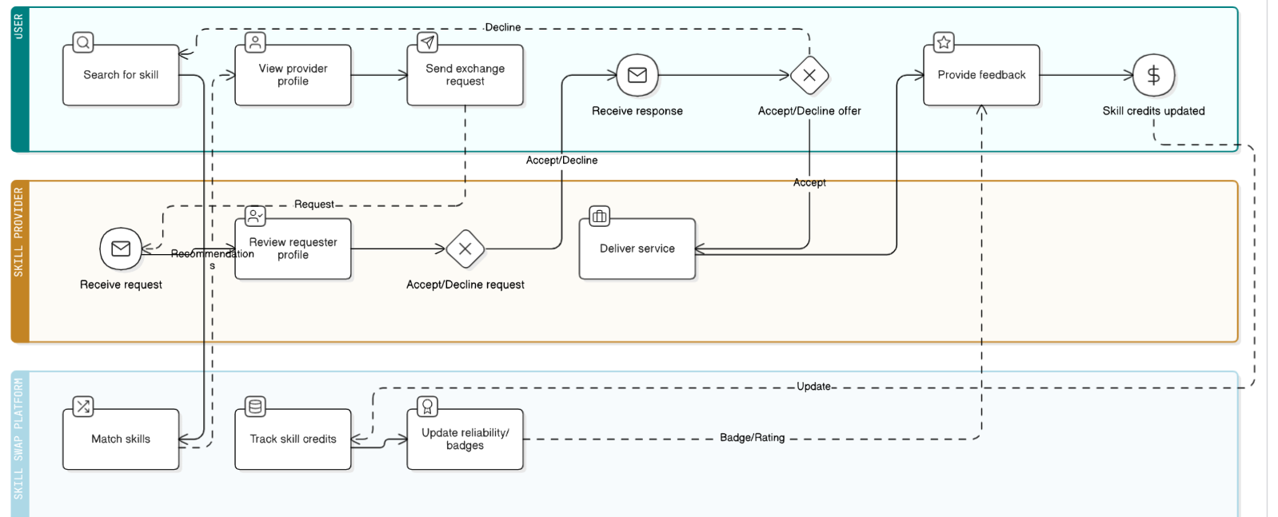
System Architecture

Slide 9
Technology Used
Modern Full Stack
Frontend (Client-Side)
The frontend is what users interact with in a web app.
React.js (Most popular)
Next.js (React + server-side rendering & routing)
Backend (Server-Side)
The backend handles logic, data processing, and APIs.
JavaScript (Node.js)
Python (FastAPI, Django)
Database
Databases store the application's data.
PostgreSQL

Slide 10
References
Botsman, R. & Rogers, R. (2010) – What’s Mine Is Yours: The Rise of Collaborative Consumption
Explores the rise of the sharing economy and how people are shifting from ownership to access, which directly relates to skill swapping.
Sundararajan, A. (2016). The Sharing Economy:
The End of Employment and the Rise of Crowd-Based Capitalism. MIT Press.
Agyeman, J., McLaren, D., & Schaefer-Borrego, A. (2013) – Sharing Cities
Talks about sustainable communities that grow through collaborative exchanges, including timebanks and skill swaps.
Resnick, P., & Zeckhauser, R. (2002). Trust among strangers in internet transactions: Empirical analysis of eBay’s reputation system. The Economics of the Internet and E-commerce, 11(1), 127–157.

Slide 11
Conclusion
The Skill Swap Network reimagines how individuals grow and support one another by fostering a collaborative, cash-free ecosystem rooted in mutual benefit. By enabling skill exchange among startups, freelancers, and individuals, it breaks down economic barriers and builds a culture of shared learning and trust. This platform not only democratizes access to knowledge but also strengthens community bonds, making personal and professional development more inclusive and sustainable for all.
Github Repository Link:
https://github.com/Jobin1804/Git_Github.git

Slide 12


Thank You

